Slide 1
Genetic Variant Classification
Predicting whether a variant will have conflicting clinical classifications

Slide 2

Summary
Introduction
Data
Preprocessing
Methods and Processes
Results and comparison
Conclusion

Slide 3
Introduction
Genetic variants is an alteration in the DNA sequence.
These variants are classified by clinical laboratories into different categories: benign, likely benign, uncertain significance, likely pathogenic, and pathogenic. From laboratory to laboratory this variant classification is not consistent which means that a laboratory A can consider a given variant as likely benign whereas a laboratory B can consider it likely pathogenic.
The goal of this project is to predict whether a variants will have conflicting clinical classification.

Slide 4
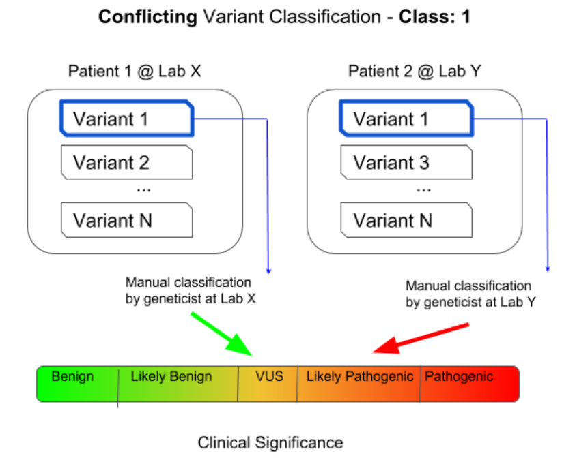

Slide 5
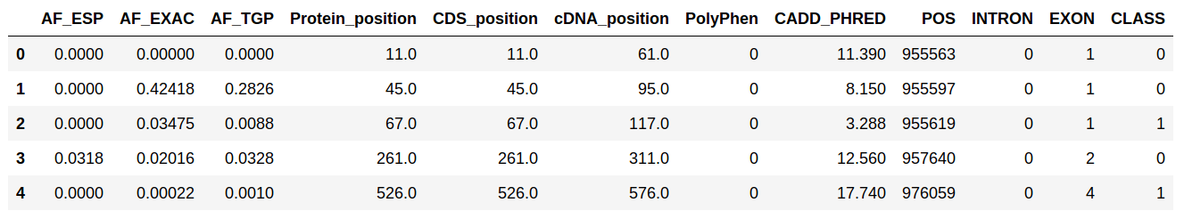
Data
The source of the data I used in this project is ClinVar platform. The data is also published on kaggle platform.
The Data set contains over 65,000 rows and 46 columns.

Slide 6
Preprocessing
I dropped the columns contained over 90% of NAs.
For the position columns, I replaced the null values with the mean of the adjacent values.
I parsed the Intron and Exon columns to extract their length and position.
I dropped some highly correlated features.
I mapped the ordinal features
I created dummy variables for the nominal variables

Slide 7
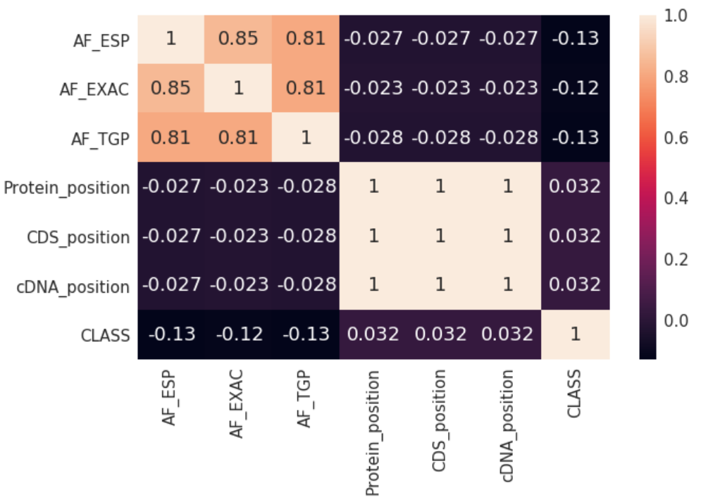

Slide 8
Methods and Processes
For feature selection I used:
Random Forest
B) For prediction I used:
Random Forest
XGBoost
Logistic Regression
SGDClassifier
Gaussian Naive Bayes

Slide 9
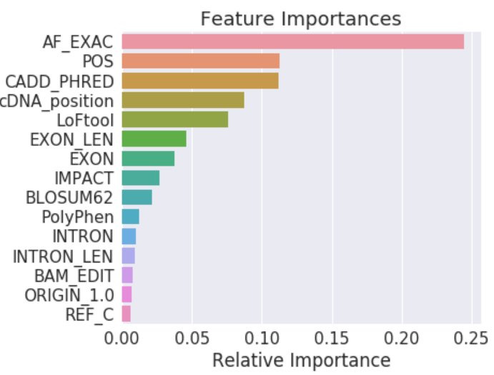
Results and Comparison
Feature selection
Allele Frequency from ExAC is the
most important feature.
I selected a subset of 65 variables
for predictions.

Slide 10
Results and Comparison
B) predictions
Random Forest classifier outperformed the other models in terms of accuracy, and ROC curve.
Model | XGBoost | Random Forest | Logistic Regression | GaussianNB | SGDClassifier
Accuracy | 0.7565 | 0.7574 | 0.7461 | 0.675 | 0.7459
ROC curve | 0.55 | 0.58 | 0.5 | 0.55 | 0.5

Slide 11
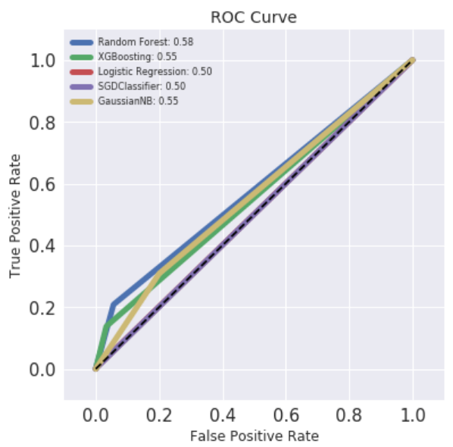

Slide 12
Conclusion
Allele frequency, variant position in the chromosome, and deleteriousness score of the SNV(single nucleotide variant) are the most important features.
The models in this project didn’t perform well, but I believe with a more sophisticated models and more relevant features the performance can be improved substantially. Therefore, there is a possibility to solve this problem with machine learning algorithms.

Slide 13

Questions???

